Slide 1
Power BI DAX in a Day
REMOVE THIS COMMENT BEFORE TEACHING
Enter your name and company
August 2021 BETA release

Slide 2
Course modules
01:Underlying Constructs: Data Models & Vertipaq Compression
02: Write DAX Formulas
03: Define Calculated Tables and Columns
04: Define Measures
05: Use DAX Iterator Functions
06: Modify Filter Context
07: Use DAX Time Intelligence Functions
BETA version

Slide 3
Agenda (times are approximate and will be fluid with the class)
Morning
15 Minutes | Review
25 Minutes | Iterator Functions
20 Minutes | Lab 05
10 Minutes | Lab Review
10 Minutes | Break
45 Minutes | Modifying Filter Context
30 Minutes | Lab 06
10 Minutes | Lab Review
10 Minutes | Break
25 Minutes | Time Intelligence Functions
15 Minutes | Lab 07
10 Minutes | Lab 07 Review
15 Minutes | Open Q&A Time
Notes:
Key message: in this workshop we will cover the breath of Power BI capabilities.
After analyzing and visualizing the dataset provided in the workshop, you will use these skills to get started on your own data.

Slide 4
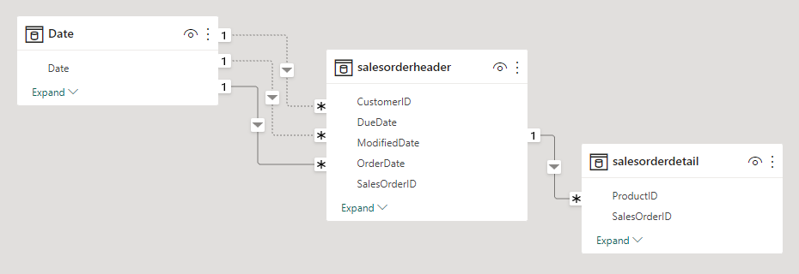
Relational Paths
Star or Snowflake Schemas

Slide 5
Encoding: Final Output
AMOUNT
STATE
PRODUCT CATEGORY
Amount
120
70
90
150
135
185
55
0
210
140
State | Index
Missouri | 0
Arkansas | 1
Kansas | 2
Illinois | 3
ProductCategory | Index
High Powered Gaming Personal Computer | 0
Mid Powered Business Laptop | 1
Low Powered 2-in-1 Laptop | 2
Tablet | 3
Index | Start | Count
0 | 1 | 1
1 | 2 | 1
2 | 3 | 1
3 | 4 | 2
1 | 6 | 2
2 | 1 | 1
0 | 1 | 1
3 | 1 | 1
Index | Start | Count
0 | 1 | 3
1 | 4 | 3
2 | 7 | 2
3 | 9 | 2
FORMULA =
X / 10 – (2800/10)

Slide 6
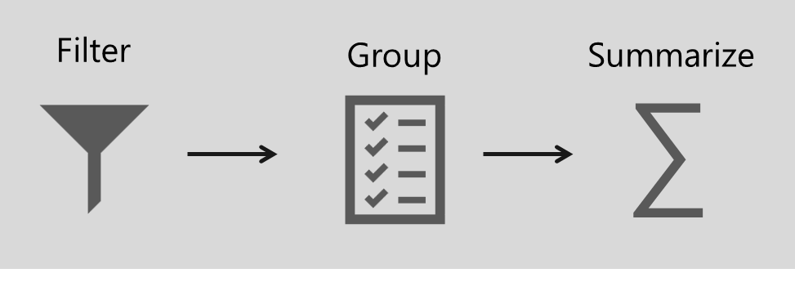
Define analytic query
An Analytic query retrieves data from a data model
It has three distinct phases:
Filter
Group
Summarize
BETA version
Notes:
An analytic query is a query that produces a result from a data model.
Each Power BI visual, in the background, submits an analytic query to Power BI to query the model.
The analytic query is written as a Data Analysis Expressions (DAX) query statement.
However, you don't need to write a native DAX statement; you only need to configure report visuals by mapping dataset fields.

Slide 7
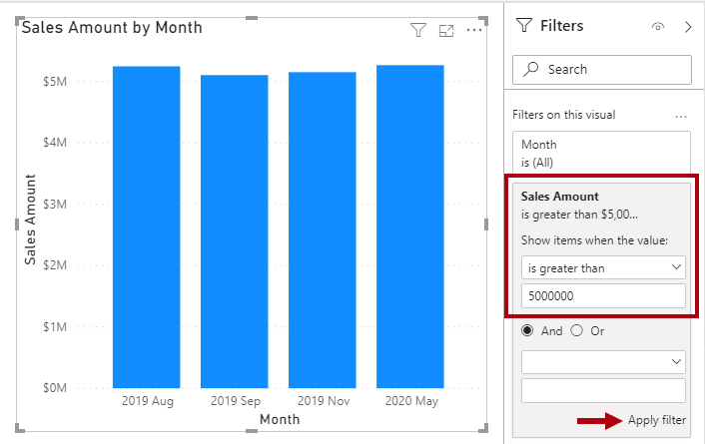
Configure report visuals
Measures
Measures are designed to summarize
They can be used to filter
However, they filter groups by the measure—for example, show only months where the sales amount (summarization) is greater than $5M
They cannot be used to group data
BETA version
Notes:
Measures are designed to summarize model data; they can't be used to group data.
However, measures can be used to filter data in one special case: to use a measure to filter a visual when the visual displays the measure and the filter is a visual-level filter (so, not a report or page-level filter).
When used in this way, a measure filter is applied after the analytic query has summarized data.
This process is done to eliminate groups where the measure filter condition is not true. (For those who are familiar with SQL syntax, a measure that used to filter a visual is like the HAVING clause in a SELECT statement.)
The following figure shows the stacked column visual adjusted to display groups (months) when sales amounts exceed $5 million.
This adjustment is done in the Filters pane by applying a filter to the Sales Amount field: Configure the filter to show items when the value is greater than 5000000.
Remember to select Apply filter, which is located in the lower-right corner of the card.
Notice that only four groups (months) have sales amounts exceeding $5 million.

Slide 8
Describe DAX calculation types
DAX can be used to create three types of calculations:
Calculated table
Calculated column
Measure
DAX can also be used to define row-level security (RLS) rules
RLS is not in scope for this course
Notes:
By using Data Analysis Expressions (DAX), you can add three types of calculations to your data model:
NOTE:
DAX can also be used to define row-level security (RLS) rules, which are expressions that enforce filters over model tables.
However, rules aren't considered to be model calculations so they're out of scope for this module. For more information, see Row-level security (RLS) with Power BI .

Slide 9
Calculated columns and measures
There are differences between calculated column and measure
 | Columns | Measures
Purpose | Extend table | Summarize model data
Evaluation | Row context at data refresh-time | Filter context at query-time
Storage | Stores value in each table row | Never stores value
Visual use | Filter, group, or summarize | Designed to summarize
Notes:
DAX beginners often experience a degree of confusion about calculated columns and measures.
The following section reviews the similarities and differences between both.
Regarding similarities between calculated columns and measures, both are:
Calculations that you can add to your data model.
Defined by using a DAX formula.
Referenced in DAX formulas by enclosing their names within square brackets.
The areas where calculated columns and measures differ include:
Purpose -
Calculated columns extend a table with a new column, while measures define how to summarize model data.
Evaluation -
Calculated columns are evaluated by using row context at data refresh time, while measures are evaluated by using filter context at query time.
Filter context is introduced in a later module; it's an important topic to understand and master so that you can achieve sophisticated summarizations.
Storage -
Calculated columns (in Import storage mode tables) store a value for each row in the table, but a measure never stores values in the model.
Visual use -
Calculated columns (like any column) can be used to filter, group, or summarize (as an implicit measure), whereas measures are designed to summarize.

Slide 10
Power BI DAX in a Day
Module 05
Use DAX Iterator Functions

Slide 11
Module outline
05: Integrate Content with the Power BI Client APIs
Describe iterator functions
Use aggregation iterator functions
Calculate ranks
Notes:
This module introduces and describes the family of iterator functions. It explains what they do and how to use them. Calculations can include custom aggregation, ranking, and concatenation.

Slide 12
Describe iterator functions
Iterator functions enumerate all rows of given table and evaluate a given expression for each row
They provide flexibility over how calculations summarize data
All iterator functions require Table and Expression
The expression must return scalar or single value
Iterator functions are easily identified by the appended “X”
For example:
Common aggregation: SUMX, AVERAGEX, COUNTX, MINX, and MAXX
Special: CONCATENATEX, and RANKX
Notes:
Data Analysis Expressions (DAX) include a set of functions known as iterator functions.
Iterator functions enumerate all rows of a given table and evaluate a given expression for each row. They provide you with flexibility and control over how your model calculations will summarize data.
By now, you're familiar with single-column summarization functions, including SUM, COUNT, MIN, MAX, and others. Each of these functions has an equivalent iterator function that's identified by the "X" suffix, such as SUMX, COUNTX, MINX, MAXX, and others.
Additionally, specialized iterator functions exist that perform filtering, ranking, semi-additive calculations over time, and more.
Characteristic of all iterator functions, you must pass in a table and an expression. The table can be a model table reference or an expression that returns a table object. The expression must evaluate to a scalar value.

Slide 13
Describe iterator functions
Example
Measure = SUMX( <Table>, <Expression> )
Notes:
This is what the signature of a common iterator function (SUMX) looks like.

Slide 14
Describe iterator functions
Example
Revenue = SUMX( Sales, Sales[Order Quantity] * Sales[Unit Price] )
Notes:
Now, consider the example of the Revenue measure. It iterates each row of the Sales table (in filter context) and multiplies the Order Quantity column by the Unit Price column.
Finally, it sums all row calculations together to produce total revenue.

Slide 15
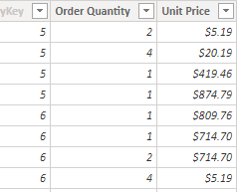
Describe iterator functions
Example
10.38
80.76
419.46
874.79
809.76
714.70
1,429.40
…
∑
208,202.17
Notes:
Use this slide to demonstrate how Power BI evaluates the Revenue measure.
[CLICK] once to commence showing the calculation method and result.

Slide 16
Describe iterator functions
Equivalent expressions
Revenue = SUM(Sales[Sales Amount])
Revenue = SUMX( Sales, Sales[Sales Amount] )
Notes:
Compare the two expressions, and then explain that they produce the same result.
In fact, Power BI will transpose the first example to become the second example. So, the SUM function is in fact a shorthand way to use an iterator function. It is the preferred way when aggregating the values of a single column.

Slide 17
Describe iterator functions
Evaluation context
It is important to understand how context works with iterator functions
Table is evaluated using filter context
Expression is evaluated using row context
Notes:
It's important to understand how context works with iterator functions. Because iterator functions enumerate over table rows, the expression is evaluated for each row in row context, similar to calculated column formulas.
The table is evaluated in filter context, so if you're using the previous Revenue measure definition example, if a report visual was filtered by fiscal year FY2020, then the Sales table would contain sales rows that were ordered in that year.
Filter context is described in the filter context module.
Tip:
When you are using iterator functions, make sure that you avoid using large tables (of rows) with expressions that use expansive DAX functions.
Some functions, like the SEARCH DAX function, which scans a text value that looks for specific characters or text, can result in slow implementation.
Also, the LOOKUPVALUE DAX function might result in a slow, row-by-row retrieval of values.
In this second case, use the RELATED DAX function instead, whenever possible.

Slide 18
Calculate ranks
The RANKX function is a special iterator function
It returns the ranking of a number in a list of numbers for each row in the table argument
RANKX ( <table> , <expression> [, <value>[, <order>[, <ties>]]]])
Notes:
The RANKX DAX function is a special iterator function you can use to calculate ranks.
Like all iterator functions, you must pass in a table and an expression. Optionally, you can pass in a rank value to find the order direction or to help you determine how to handle ranks when values are tied.

Slide 19
Calculate ranks
Order direction
Order direction is either ascending or descending
Revenue values use descending (favorable)
Rank customer complains ascending (unfavorable)
Default direction is descending
Notes:
Order direction is either ascending or descending.
When ranking something favorable, like revenue values, you're likely to use descending order so that the highest revenue will be ranked first.
When ranking something unfavorable, like customer complaints, you might use ascending order so that the lowest number of complaints will be ranked first.
When you don't pass in an order argument, the function will use descending order.

Slide 20
Calculate ranks
Handle ties
Either SKIP or DENSE
DENSE has no gaps in ranking sequence
For example: 1, 2, 2, 3, 4
SKIP adds gaps to ranking sequence
For example: 1, 2, 2, 4, 5
Default is to SKIP
Notes:
You can handle ties by skipping rank values or using dense ranking, which uses the next rank value after a tie. When you don't pass in a ties argument, the function will use skipped.

Slide 21
Lab 5
Use DAX iterator functions in Power BI Desktop models
Notes:
Students will use the lab document to complete the lab.

Slide 22
Power BI DAX in a Day
Module 06
Modify Filter Context

Slide 23
Module outline
06: Modify Filter Context
Describe filter context
Use the CALCULATE function
Use filter modifier functions
Examine filter context
Perform context transition
Notes:
This module describes filter context and why it’s sometimes necessary to modify filter context. The main topic is the CALCULATE function.

Slide 24
Describe filter context
Filter context describes the filters applied during the evaluation of a measure or measure expression
Filters can be applied directly to columns
Filters can be applied indirectly via relationships
Notes:
Filter context describes the filters that are applied during the evaluation of a measure or measure expression.
Filters can be applied directly to columns, like a filter on the Fiscal Year column in the Date table for the value FY2020.
Additionally, filters can be applied indirectly, which happens when model relationships propagate filters to other tables.
For example, the Sales table receives a filter through its relationship with the Date table, filtering the Sales table rows to those with an OrderDateKey column value in FY2020.

Slide 25
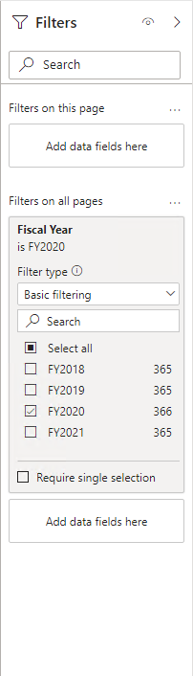
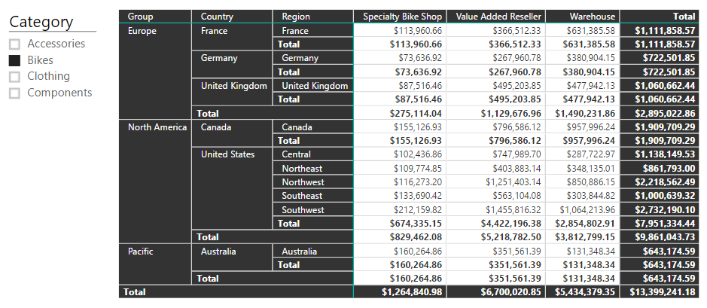
Describe filter context
Example
Notes:
Use this example to describe the filter context for the single cell in the matrix visual. There are seven [CLICK]s to complete the animation. With each click, describe the filter that applies to the value.

Slide 26
Describe filter context
Filter origin
Not all filters are applied at report design time
Report users can add or modify filters when interacting with the report by:
Modifying slicer selections
Modifying filters in the Filters pane
Selecting visual elements to cross-filter or cross-highlight other visuals
Notes:
Not all filters are applied at report design time.
Filters can be added when a report user interacts with the report.
They can modify filter settings in the Filters pane, and they can cross-filter or cross-highlight visuals by selecting visual elements like columns, bars, or pie chart segments.
These interactions apply additional filters to report page visuals (unless interactions have been disabled).
It's important to understand how filter context works.
It guides you in defining the correct formula for your calculations.
As you write more complex formulas, you'll identify times when you need to add, modify, or remove filters to achieve the desired result.

Slide 27
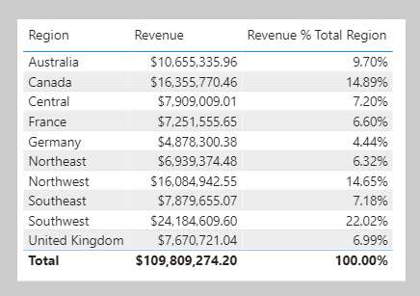
Describe filter context
Example
Notes:
Consider another example that requires your formula to modify the filter context. The objective is to produce a report visual that shows each sales region together with its revenue and revenue as a percentage of total revenue.
The Revenue % Total Region result is achieved by defining a measure expression that's the ratio of revenue divided by revenue for all regions.
Therefore, for Australia, the ratio is $10,655,335.96 divided by $109,809,274.20, which is 9.7 percent. The numerator expression doesn't need to modify filter context; it should use the current filter context (a visual that groups by region applies a filter for that region). The denominator expression, however, needs to remove any region filters to achieve the result for all regions.

Slide 28
Use the CALCULATE function
CALCULATE ( <expression> , [[<filter1>], <filter2>]…)
Notes:
You can use the CALCULATE DAX function to modify filter context in your formulas.
The syntax for the CALCULATE function is as follows:
The function requires passing in an expression that returns a scalar value and as many filters as you need.
The expression can be a measure (which is a named expression) or any expression that can be evaluated in filter context.
Filters can be Boolean expressions or table expressions.
It's also possible to pass in filter modification functions that provide additional control when you are modifying filter context.
When you have multiple filters, they're evaluated by using the AND logical operator, which means that all conditions must be TRUE at the same time.
Note:
The CALCULATETABLE DAX function performs exactly the same functionality as the CALCULATE function, except that it modifies the filter context that is applied to an expression that returns a table object.
In this module, the explanations and examples use the CALCULATE function, but keep in mind that these scenarios could also apply to the CALCULATETABLE function.

Slide 29
Use the CALCULATE function
Boolean expression filters
Boolean expression filters must evaluate as TRUE or FALSE
Each filter:
Can reference only a single column
Can not reference measures
Can not use functions that scan or return table
Notes:
A Boolean expression filter is an expression that evaluates to TRUE or FALSE.
Boolean filters must abide by the following rules:
They can reference only a single column
They cannot reference measures
They cannot use functions that scan or return a table that includes aggregation functions like SUM

Slide 30
Use the CALCULATE function
Boolean expression filters » Example
Revenue Red = CALCULATE( [Revenue], 'Product'[Color] = "Red" )
Notes:
In this example, you will create a measure. First, download and open the Adventure Works DW 2020 M06.pbix file.
Then, add the following measure definition that filters the Revenue measure by using a Boolean expression filter for red products.

Slide 31
Use the CALCULATE function
Boolean expression filters » Example (Continued)
Revenue Red = CALCULATE([Revenue], 'Product'[Color] = "Red")
Revenue Red = CALCULATE( [Revenue],
FILTER(
'Product', 'Product'[Color] = "Red" )
)
Notes:
All filter expressions that are passed in to the CALCULATE function are table filter expressions.
A Boolean filter expression is a shorthand notation to improve the writing and reading experience.
Internally, Microsoft Power BI translates Boolean filter expressions to table filter expressions, which is how it translates your Revenue Red measure definition.
The top example is internally re-written to be the same as the bottom expression

Slide 32
Use the CALCULATE function
Table expression filters
Table expression filters apply a table object as a filter
Each filter:
Can be a reference to model table
Can be a DAX function that returns a table object
It is common to use the FILTER function to create filters
Notes:
A table expression filter applies a table object as a filter.
It could be a reference to a model table; however, it's likely a DAX function that returns a table object.
Commonly, you'll use the FILTER DAX function to apply complex filter conditions, including those that can't be defined by a Boolean filter expression.
The FILTER function is classed as an iterator function, and so you would pass in a table, or table expression, and an expression to evaluate for each row of that table.
The FILTER function returns a table object with exactly the same structure as one that the table passed in.
Its rows are a subset of those rows that were passed in, meaning the rows where the expression evaluated as TRUE.

Slide 33
Use the CALCULATE function
Table expression filters » Example
Revenue High Margin Products = CALCULATE( [Revenue], FILTER(
'Product',
'Product'[List Price] > 'Product'[Standard Cost] * 2 )
)
Notes:
In this example, you will create a measure. First, download and open the Adventure Works DW 2020 M06.pbix file.
Then, add the following sure. In this example, the FILTER function filters all rows of the Product table that are in filter context. Each row for a product where its list price exceeds double its standard cost is displayed as a row of the filtered table. Therefore, the Revenue measure is evaluated for all products that are returned by the FILTER function

Slide 34
Use the CALCULATE function
Table filter columns » Filter behavior
If columns are not in filter context, new filters are added to filter context
If columns already in filter context, existing filters are overwritten
Notes:
Two possible standard outcomes occur when you add filter expressions to the CALCULATE function:
If the columns (or tables) aren't in filter context, then new filters will be added to the filter context to evaluate the CALCULATE expression.
If the columns (or tables) are already in filter context, the existing filters will be overwritten by the new filters to evaluate the CALCULATE expression.

Slide 35
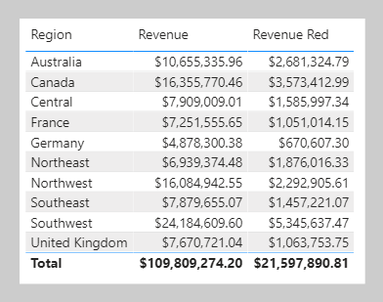
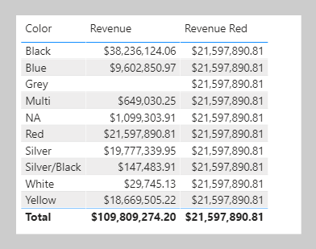
Modify filter context
Table filter columns » Filter behavior » Example
New filter added
Existing filter overwritten
Notes:
The following examples show how adding filter expressions to the CALCULATE function works.
As in the previous activity, the Revenue Red measure was added to a table visual that groups by region and displays revenue. Because no filter is applied on the Color column in the Product table, the evaluation of the measure adds a new filter to filter context. In the first row, the value of $2,681,324.79 is for red products that were sold in the Australian region.
In the second table visual, the first column of the table visual is switched from Region to Color. It produces a different result because the Color column in the Product table is now in filter context. The Revenue Red measure formula evaluates the Revenue measure by adding a filter on the Color column (to red) in the Product table.
Consequently, in this visual that groups by color, the measure formula overwrites the filter context with a new filter. This result might or might not be what you want.
The next unit introduces the KEEPFILTERS DAX function, which is a filter modification function that you can use to preserve filters rather than overwrite them.

Slide 36
Use filter modifier functions
When using CALCULATE, it is possible to pass in filter modification functions
Filter modifier functions include:
REMOVEFILTERS – Remove filters from all tables, a single table or column(s)
ALL – Remove filters from a single table or column(s)
ALLEXCEPT – Remove filters from all columns of a single table, except those explicitly passed in
ALLNONBLANKROW – From the parent table of a relationship, returns all rows but the blank row, or all distinct values of a column but the blank row, and disregards any context filters that might exist
Notes:
When using the CALCULATE function, you can pass in filter modification functions, which allow you to accomplish more than adding filters.
The REMOVEFILTERS function is relatively new. In previous versions of DAX, you removed filters by using the ALL DAX function or variants including the ALLEXCEPT and the ALLNOBLANKROW DAX functions.
These functions behave as both filter modifiers and as functions that return table objects of distinct values. These functions are mentioned now because you're likely to find documentation and formula examples that remove filters by using them.

Slide 37
Use filter modifier functions
Use inactive relationships
Use the USERRELATIONSHIP function to make an inactive relationship active during the evaluation of the CALCULATE function
Revenue Shipped = CALCULATE( [Revenue], USERELATIONSHIP(
'Date'[DateKey],
'Sales'[ShipDateKey]
) )
Notes:
An inactive model relationship can only propagate filters when the USERELATIONSHIP DAX function is passed as a filter expression to the CALCULATE function.
When you use this function to engage an inactive relationship, the active relationship will automatically become inactive.
Review an example of a measure definition that uses an inactive relationship to calculate the Revenue measure by shipped dates:

Slide 38
Use filter modifier functions
Modify relationship behavior
Use CROSSFILTER to modify relationship behavior
Modify filter direction(s)
Disable filters
Notes:
You can modify the model relationship behavior when an expression is evaluated by passing the CROSSFILTER DAX function as a filter expression to the CALCULATE function.
It's an advanced capability. The CROSSFILTER function can modify filter directions (from both to single or from single to both) and even disable a relationship.

Slide 39
Examine filter context
It is possible to examine filter context by using certain DAX functions:
VALUES
HASONEVALUE
SELECTEDVALUE
ISFILTERED
ISCROSSFILTERED
ISINSCOPE
Notes:
It is possible to examine filter context by using certain DAX functions:
VALUES
HASONEVALUE
SELECTEDVALUE
ISFILTERED
ISCROSSFILTERED
ISINSCOPE

Slide 40
Examine filter context
VALUES function
Use the VALUES function determines what values are in filter context
VALUES ( <TableNameOrColumnName> )
Use the HASONEVALUE function to determine if the context for a specific column has been filtered down to one distinct value only
Use the SELECTEDVALUE function to return the value when one value is in context
Notes:
The VALUES DAX function lets your formulas determine what values are in filter context.
The VALUES function syntax is as follows:
The function requires passing in a table reference or a column reference.
When you pass in a table reference, it returns a table object with the same columns that contain rows for what's in filter context.
When you pass in a column reference, it returns a single-column table of unique values that are in filter context.
The function always returns a table object and it's possible for a table to contain multiple rows.
Therefore, to test whether a specific value is in filter context, your formula must first test that the VALUES function returns a single row.
Two functions can help you accomplish this task:
the HASONEVALUE and
the SELECTEDVALUE DAX functions.
The HASONEVALUE function returns TRUE when a given column reference has been filtered down to a single value.
The SELECTEDVALUE function simplifies the task of determining what a single value could be. When the function is passed a column reference, it'll return a single value, or when more than one value is in filter context, it'll return BLANK (or an alternate value that you pass to the function).

Slide 41
Examine filter context
Other functions
ISFILTERED - Returns TRUE when a passed-in column reference is directly filtered
ISCROSSFILTERED - Returns TRUE when a passed-in column reference is indirectly filtered
ISINSCOPE - Returns TRUE when a passed-in column reference is the level in a hierarchy of levels
Notes:
Three other functions that you can use to test filter state are:
ISFITLERED DAX function - Returns TRUE when a passed-in column reference is directly filtered.
ISCROSSFILTERED DAX function - Returns TRUE when a passed-in column reference is indirectly filtered.
A column is cross-filtered when a filter that is applied to another column in the same table, or in a related table, affects the reference column by filtering it.
ISINSCOPE DAX function - Returns TRUE when a passed-in column reference is the level in a hierarchy of levels.

Slide 42
Perform context transition
When a measure or measure expression is evaluated within row context, it undergoes context transition
In this case, the CALCULATE function applies row context values as filters
It occurs when:
A calculated column formula uses a measure
An expression in an iterator function is evaluated
Notes:
What happens when a measure or measure expression is evaluated within row context?
This scenario can happen in a calculated column formula or when an expression in an iterator function is evaluated.

Slide 43
Perform context transition
Measures used by an expression that is evaluated in row context automatically undergo context transition
To force context transition, wrap a measure expression inside the CALCULATE function—it does need to pass in any filters
Notes:
Measures used by an expression that is evaluated in row context automatically undergo context transition.
To force context transition, wrap a measure expression inside the CALCULATE function—it does need to pass in any filters.

Slide 44
Lab 6
Modify Filter Context in Power BI Desktop models
Notes:
Students will use the lab document to complete the lab.

Slide 45
Power BI DAX in a Day
Module 07
Use DAX Time Intelligence Functions

Slide 46
Module outline
07: Use DAX Time Intelligence Functions
Define Time Intelligence
Use Time Intelligence functions
Notes:
This module defines Time Intelligence and provides common use cases.

Slide 47
Define Time Intelligence
Time Intelligence relates to calculations over dates, months, quarters, or years
It involves modifying the filter context for date filters
The model requires a date table
The date table can be created using the CALENDAR or CALENDARAUTO functions
Notes:
Time intelligence relates to calculations over time. Specifically, it relates to calculations over dates, months, quarters, or years, and possibly time.
Note: Rarely would you need to calculate over time in the sense of hours, minutes, or seconds.
In Data Analysis Expressions (DAX) calculations, time intelligence means modifying the filter context for date filters.

Slide 48
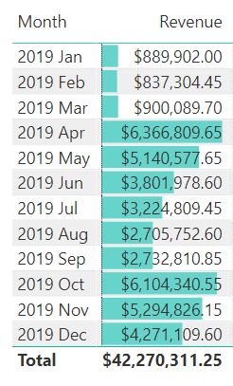
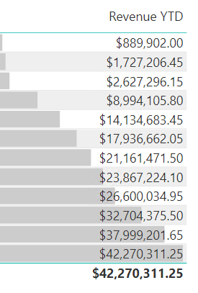
Define Time Intelligence
Example
Notes:
Here’s an example. It’s easy to show monthly revenue: group by month and sum the revenue column.
[CLICK] By applying Time Intelligence, a measure can be defined to compute the accumulation of revenue over the year. This type of calculation is known as a year-to-date (YTD) calculation.
Describe that the accumulation of revenue over the year is a manipulation of the date filter. Consider the YTD value for 2019 Feb. It isn’t the sum of revenue in Feb. Rather, it’s the sum of revenue from the beginning of the year (2019 Jan) until 2019 Feb.

Slide 49
Define Time Intelligence
Date table » Requirements
The date table must have a Date (or Date/time) column
The Date column:
Must contain unique values
Must not contain BLANKS
Must not have missing dates (gaps)
Must span full years (financial or traditional)
The date table should be marked as a date table
Notes:
The date table (or tables) must meet certain requirements. The date table should be marked as a date table (described next).

Slide 50
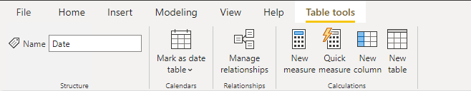
Define Time Intelligence
Date table » Marking
To use the Time Intelligence functions, a table must be marked as a date table
It also allows the model tables to use a non-date type key
The date key can be in ISO format, for example 20210630
Multiple model tables can be marked as date tables
Notes:
To use the Time Intelligence functions, a table must be marked as a date table.
Multiple model tables can be marked as date tables.
For more information, see https://docs.microsoft.com/power-bi/guidance/model-date-tables

Slide 51
Use Time Intelligence functions
DAX has many inbuilt Time Intelligence functions
For example, TOTALYTD and PREVIOUSYEAR
It is possible to replace them using CALCUALTE
However, that requires more work and could be slower for Power BI to evaluate
Notes:
DAX includes several time intelligence functions to simplify the task of modifying date filter context. You could write many of these intelligence formulas by using a CALCULATE function that modifies date filters, but that would create more work.
Note:
Many DAX time intelligence functions are concerned with standard date periods, specifically years, quarters, and months.
If you have irregular time periods (for example, financial months that begin mid-way through the calendar month), or you need to work with weeks or time periods (hours, minutes, and so on), the DAX time intelligence functions won't be helpful.
Instead, you'll need to use the CALCULATE function and pass in hand-crafted date or time filters.

Slide 52
Use Time Intelligence functions
Common use cases
Cumulative totals
Period comparisons
New customer orders by month
Stock on-hand value
Notes:
Time intelligence calculations modify date filter contexts.
They can help you answer these time-related questions:
What's the accumulation of revenue for the year, quarter, or month?
What revenue was produced for the same period last year?
What growth in revenue has been achieved over the same period last year?
How many new customers made their first order in each month?
What's the inventory stock on-hand value for the company's products?

Slide 53
Use Time Intelligence functions
Summarization over time
DATESYTD – Returns a single-column table of dates
TOTALYTD – Evaluates expression for year-to-date (YTD)
DATESBETWEEN – Returns single-column table with range dates
DATESINPERIOD – Returns single-column table with range of dates
Notes:
One group of DAX time intelligence functions is concerned with summarizations over time:
DATESYTD DAX function - Returns a single-column table that contains dates for the year-to-date (YTD) in the current filter context.
This group also includes the DATESMTD and DATESQTD DAX functions for month-to-date (MTD) and quarter-to-date (QTD).
You can pass these functions as filters into the CALCULATE DAX function.
TOTALYTD DAX function - Evaluates an expression for YTD in the current filter context.
The equivalent QTD and MTD DAX functions of TOTALQTD and TOTALMTD are also included.
DATESBETWEEN DAX function - Returns a table that contains a column of dates that begins with a given start date and continues until a given end date.
DATESINPERIOD DAX function - Returns a table that contains a column of dates that begins with a given start date and continues for the specified number of intervals.
Note:
While the TOTALYTD function is simple to use, you are limited to passing in one filter expression.
If you need to apply multiple filter expressions, use the CALCULATE function and then pass the DATESYTD function in as one of the filter expressions.

Slide 54
Use Time Intelligence functions
Shifting time periods
DATEADD – Returns single-column table of dates shifted by interval
PARALLELPERIOD – Returns single-column table of parallel dates
SAMEPERIODLASTYEAR – Returns dates shifted back one year
Many others – NEXTDAY, NEXTMONTH, NEXTQUARTER, NEXTYEAR, PREVDAY, PREVMONTH, PREVQUARTER ,PREVYEAR
Notes:
Another group of DAX time intelligence functions is concerned with shifting time periods:
DATEADD DAX function - Returns a table that contains a column of dates, shifted either forward or backward in time by the specified number of intervals from the dates in the current filter context.
PARALLELPERIOD DAX function - Returns a table that contains a column of dates that represents a period that is parallel to the dates in the specified dates column, in the current filter context, with the dates shifted a number of intervals either forward in time or back in time.
SAMEPERIODLASTYEAR DAX function - Returns a table that contains a column of dates that are shifted one year back in time from the dates in the specified dates column, in the current filter context.
Many helper DAX functions for navigating backward or forward for specific time periods, all of which returns a table of dates. These helper functions include NEXTDAY , NEXTMONTH , NEXTQUARTER , NEXTYEAR , and PREVIOUSDAY , PREVIOUSMONTH , PREVIOUSQUARTER , and PREVIOUSYEAR .

Slide 55
Use Time Intelligence functions
Return a single date
FIRSTDATE – Returns first date in current filter context
LASTDATE – Returns last date in current filter context
Notes:
Other DAX time intelligence functions exist that are concerned with returning a single date.
You'll learn about these functions by applying them in two different scenarios.
The FIRSTDATE and the LASTDATE DAX functions return the first and last date in the current filter context for the specified column of dates.

Slide 56
Use Time Intelligence functions
Snapshot calculations
Inventory stock levels or account balances
Useful when tables store snapshot of values
For example, inventory stock levels or account balances
Calculations can summarize across any dimension except date
For example, stock level counts by product category works, but not by date range
Notes:
Occasionally, fact data is stored as snapshots in time. Common examples include inventory stock levels or account balances. A snapshot of values is loaded into the table on a periodic basis.
When summarizing snapshot values (like inventory stock levels), you can summarize values across any dimension except date.
Adding stock level counts across product categories produces a meaningful summary but adding stock level counts across dates does not. Adding yesterday's stock level to today's stock level isn't a useful operation to perform (unless you want to average that result).
When you are summarizing snapshot tables, measure formulas can rely on DAX time intelligence functions to enforce a single date filter.

Slide 57
Use Time Intelligence functions
Snapshot calculations » Functions
LASTNONBLANK – Returns the last date that produces a non-BLANK result
FIRSTNONBLANK – Returns the first date that produces a non-BLANK result
LASTNONBLANKVALUE – Returns the value of the last date that produces a non-BLANK result
FIRSTNONBLANKVALUE – Returns the value of the first date that produces a non-BLANK result
Notes:
The LASTNONBLANK function is an iterator function.
It returns the last date that produces a non-BLANK result.
It achieves this result by iterating through all dates in filter context in descending chronological order.
(Conversely, the FIRSTNONBLANK iterates in ascending chronological order.)
For each date, it evaluates the passed in expression.
When it encounters a non-BLANK result, the function returns the date.
That date is then used to filter the CALCULATE function.
NOTE:
The LASTNONBLANK function evaluates its expression in row context.
The CALCULATE function must be used to transition the row context to filter context to correctly evaluate the expression.

Slide 58
Lab 7
Use DAX Time Intelligence functions in Power BI Desktop models
Notes:
Students will use the lab document to complete the lab.

